Slide 1
Tutorial 3
Statistical Computation and Analysis
Spring 2025
Notes:
Examples gallaery direct illiciation.
Predictive I have data like this and this is the model, now tell me about the prior.
Its easier to say what we think the data is like than what the prior is like.

Slide 2
Tutorial Outline
Bayes theorem
Likelihood
Posterior
Prior
Preliz
Model visualization

Slide 3

Bayes Theorem
$P\left(\left.\text{model}\right|\text{data}\right)=\frac{P\left(\left.\text{data}\right|\text{model}\right)P\left(\text{model}\right)}{\sum_{\text{models}}{P\left(\left.\text{data}\right|\text{model}\right)P\left(\text{model}\right)}}$
Prior distribution: what do we know about the values of the model before seeing the data.
Likelihood: how we will introduce our data.
Posterior distribution: the result of Bayesian analysis -> reflects all we know about our question given our data and model.
Probability distribution for the parameters in our model
Not a single value
Marginal likelihood: probability of observing the data averaged over all the possible values the parameter can take
Normalization factor
Notes:
Ml estimators – those that maximize the likelihood. Under which parameters is the data most likely?
We have to start with some idea – the prior. Then we use our data to update it.
We want to choose a prior which allows for updating it given our data (not a delta for example).
Marginal – probablitiy of the data given all possible models. But we have the data. Also called evidence.
Likelihood – probability distribution of the data – so if we integrate over the data it will give us 1, but not if we integrate over the parameter.
We integrate over the parameter in the evidence.

Slide 4

Bayes Theorem
Let’s calculate the probability of having a disease given a positive test result.
$P\left(\left.\text{d}isease\right|\text{positive} test\right)=\frac{P\left(\left.\text{positive} \text{test}\right|\text{disease}\right)P\left(\text{disease}\right)}{\sum_{\text{condition}}{P\left(\left.\text{positive} \text{test}\right|\text{condition}\right)P\left(\text{condition}\right)}}$
$P\left(positive test | disease\right)=sensitivity=\frac{\#true positive}{\# sick}$
$P\left(disease\right)=disease prevelence$
$\sum_{condition}{P\left(positive test | condition\right)P\left(condition\right)= }$
$=P\left(positive test | disease\right)P\left(disease\right)$+
$$=P\left(positive test | not disease\right)P\left(not disease\right)=$$
$$=sensitivity⋅prevelance+\frac{\#false positive}{\# not sick}⋅(1−prevelance)$$
$\frac{\#false positive}{\# not sick}=1−specificity$
Notes:
Specificity = TNR

Slide 5

Bayes Theorem
Sensitivity = 0.7
Specificity = 0.95
Prevalence = 0.05
$P\left(\left.\text{d}isease\right|\text{positive} test\right)=\frac{P\left(\left.\text{positive} \text{test}\right|\text{disease}\right)P\left(\text{disease}\right)}{\sum_{\text{condition}}{P\left(\left.\text{positive} \text{test}\right|\text{condition}\right)P\left(\text{condition}\right)}}$ $=\frac{0.7⋅0.05}{0.7⋅0.05+\left(1−0.95\right)⋅(1−0.05)}=0.42$

Slide 6

Bayes Theorem
Effect of likelihood:
Sensitivity = 0.9
Specificity = 0.95
Prevalence = 0.05
$P\left(\left.\text{d}isease\right|\text{positive} test\right)=\frac{P\left(\left.\text{positive} \text{test}\right|\text{disease}\right)P\left(\text{disease}\right)}{\sum_{\text{condition}}{P\left(\left.\text{positive} \text{test}\right|\text{condition}\right)P\left(\text{condition}\right)}}$ $=\frac{0.9⋅0.05}{0.9⋅0.05+\left(1−0.95\right)⋅(1−0.05)}=0.48$
Why does this result make sense?
The sensitivity of the test increased -> the test got better -> the chance of being sick given a positive result is higher.

Slide 7

Bayes Theorem
Effect of prior:
Sensitivity = 0.7
Specificity = 0.95
Prevalence = 0.20
$P\left(\left.\text{d}isease\right|\text{positive} test\right)=\frac{P\left(\left.\text{positive} \text{test}\right|\text{disease}\right)P\left(\text{disease}\right)}{\sum_{\text{condition}}{P\left(\left.\text{positive} \text{test}\right|\text{condition}\right)P\left(\text{condition}\right)}}$ $=\frac{0.7⋅0.2}{0.7⋅0.2+\left(1−0.95\right)⋅(1−0.2)}=0.77$
Why does this result make sense?
Even if the test’s sensitivity does not change, the fact that there’s a higher prior probability to have the disease makes the posterior higher.

Slide 8
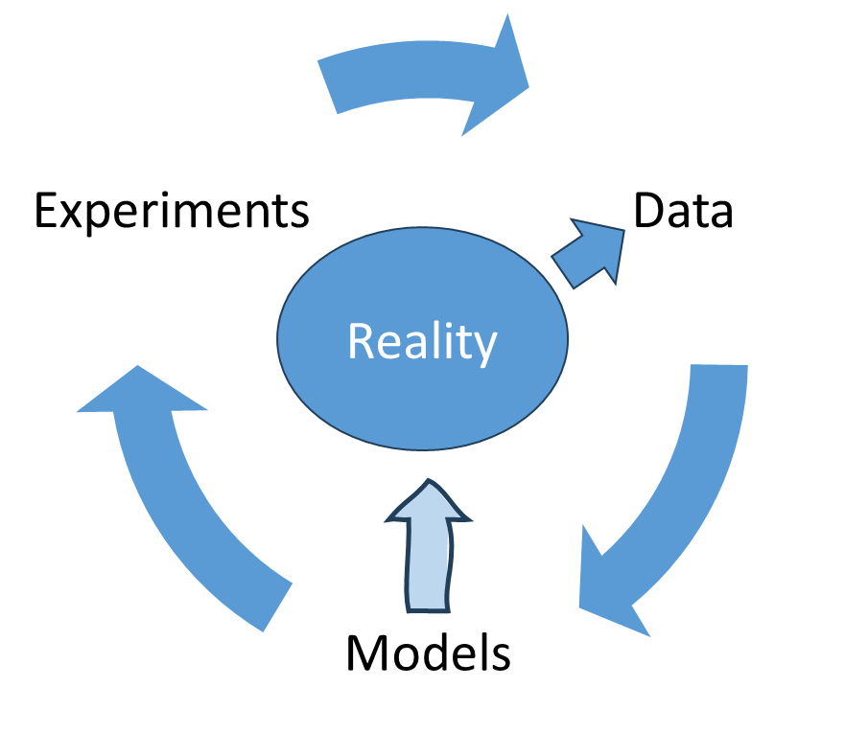

Models
A model is a specific idea about how data comes from reality
A particular distribution
With specific parameters
$P\left(\left.\text{model}\right|\text{data}\right)=\frac{P\left(\left.\text{data}\right|\text{model}\right)P\left(\text{model}\right)}{\sum_{\text{models}}{P\left(\left.\text{data}\right|\text{model}\right)P\left(\text{model}\right)}}$
$P\left(\left.\text{model}\right|\text{data}\right)∝P\left(\left.\text{data}\right|\text{model}\right)P\left(\text{model}\right)$
We will use data to update our model

Slide 9

Likelihood
Let’s model the number of emails a 3rd year biomedical engineering student receives on average per day.
What distribution is appropriate?
Poisson
$$f\left(k, λ\right)=\frac{λ^{k}e^{−λ}}{k!}$$
The probability of a given number of events occurring in a fixed interval
Events occur at a known constant mean rate - $λ$
Events occur independently of the time since the last event

Slide 10
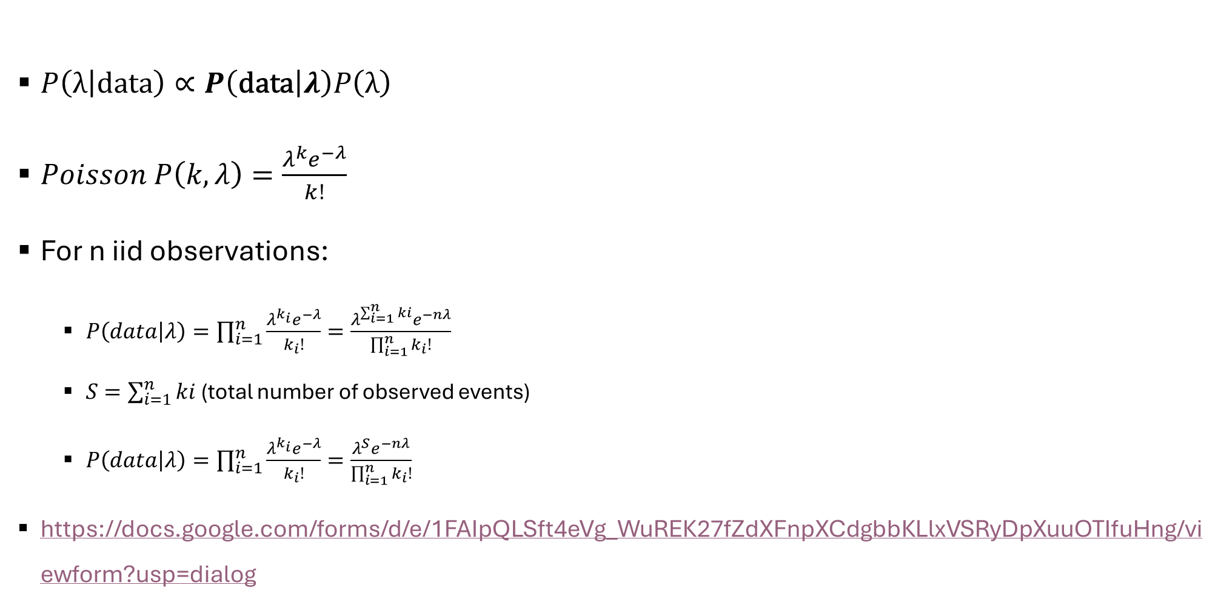
Likelihood
$P\left(\left.λ\right|\text{data}\right)∝P\left(\left.\text{data}\right|λ\right)P\left(λ\right)$
$Poisson P\left(k, λ\right)=\frac{λ^{k}e^{−λ}}{k!}$
For n iid observations:
$P\left(data | λ\right)=\prod_{i=1}^{n}{\frac{λ^{k_{i}}e^{−λ}}{k_{i}!}}=\frac{λ^{\sum_{i=1}^{n}{ki}}e^{−nλ}}{\prod_{i=1}^{n}{k_{i}!}}$
$S=\sum_{i=1}^{n}{ki}$ (total number of observed events)
$P\left(data | λ\right)=\prod_{i=1}^{n}{\frac{λ^{k_{i}}e^{−λ}}{k_{i}!}}=\frac{λ^{S}e^{−nλ}}{\prod_{i=1}^{n}{k_{i}!}}$
https://docs.google.com/forms/d/e/1FAIpQLSft4eVg_WuREK27fZdXFnpXCdgbbKLlxVSRyDpXuuOTIfuHng/viewform?usp=dialog

Slide 11

Bayes Theorem
$P\left(\left.λ\right|\text{data}\right)∝P\left(\left.\text{data}\right|λ\right)P\left(λ\right)$

Slide 12
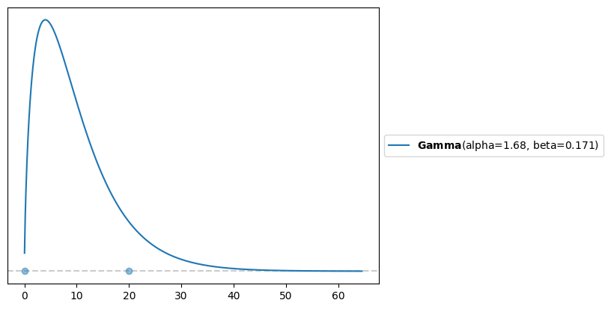

Prior
$P\left(λ\right)\sim Gamma\left(α, β\right)=\frac{β^{α}λ^{α−1}e^{−βλ}}{Γ\left(α\right)}$
Notes:
Decided that 90% of the weight should be between 0-5

Slide 13

Bayes Theorem
$P\left(\left.λ\right|\text{data}\right)∝P\left(\left.\text{data}\right|λ\right)P\left(λ\right)$
$=\frac{λ^{S}e^{−nλ}}{\prod_{i=1}^{n}{k_{i}!}}⋅$ $\frac{β^{α}λ^{α−1}e^{−βλ}}{Γ\left(α\right)}$
Leaving out the constants:
$P\left(\left.λ\right|\text{data}\right)$ $∝λ^{α−1+S}e^{−\left(β+n\right)λ}$
Therefore:
$$P\left(\left.λ\right|\text{data}\right)\sim Gamma\left(α+S,n+β\right)$$
Notes:
We know that it has to be proportional to this distribution, and then the normalizing constants will make it an actual distribution that integrates to 1. The contstants we left out don’t depend on gamma, and therefore the normalizing constants have to be those of the gamma distribution

Slide 14
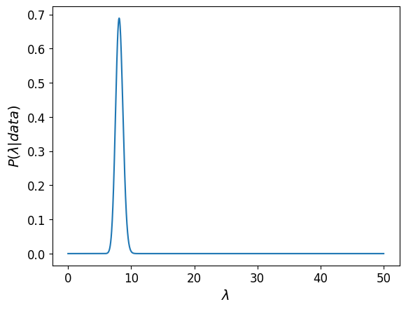

Posterior
$P\left(\left.λ\right|\text{data}\right)\sim Gamma\left(α+S,n+β\right)$
S = total number of emails received
n = Number of students
With simulated data ($λ=8)$
Notes:
Show the effect of adding each datapoint.
This is how the data affects the posterior for a set prior.

Slide 15
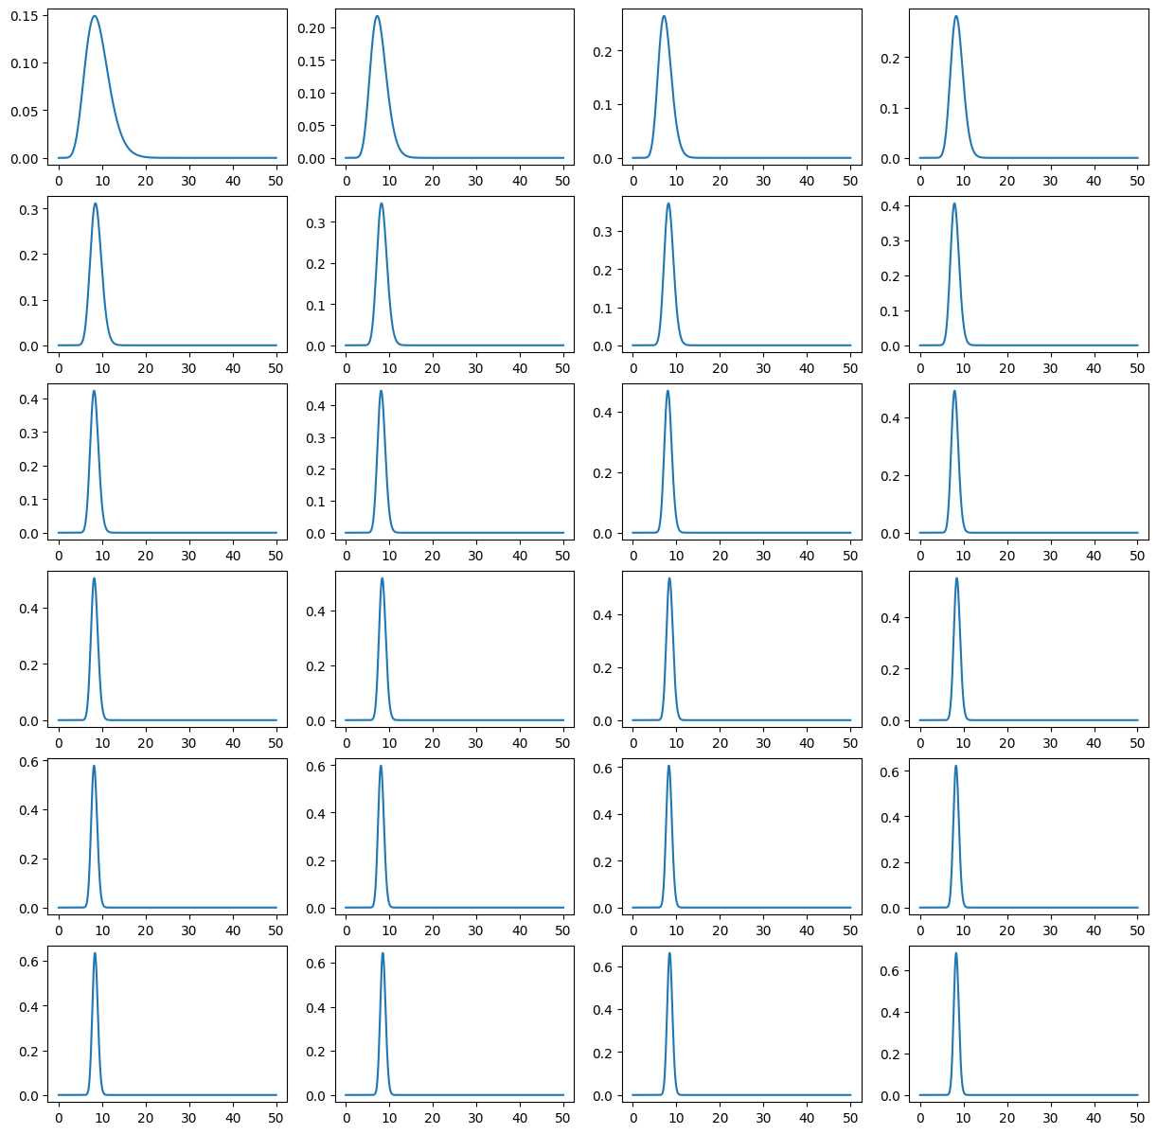
Posterior
We can see the effect of each
data point
Notes:
Show the effect of adding each datapoint.
This is how the data affects the posterior for a set prior.

Slide 16
Prior
Probability distribution
Describes our prior beliefs on the values of the model
If we have no prior beliefs, what distribution would we use?
Uniform
If we know for a fact what the values of the model are, what function would we use (hypothetical)?
Delta
In reality, we generally use something in between.

Slide 17
Prior
Choose a distribution with values that make sense.
The gamma distribution is defined for non-negative values.
The average number of emails received has to be non-negative.
The gamma distribution is a conjugate prior for the Poisson distribution.
We chose the shape and scale parameters based on our belief of how many emails students receive each day.

Slide 18
Conjugate Priors
The prior and posterior have the same shape distribution with updated parameters.
Prior | Likelihood
Gamma | Poisson
Gamma | Exponential
Beta | Binomial
Beta | Bernoulli
Gaussian | Mean: gaussian Variance: Inverse Gamma

Slide 19
Effect of the Prior
Preliz distributions documentation:
https://preliz.readthedocs.io/en/latest/distributions.html
Notes:
Show some examples with different priors

Slide 20
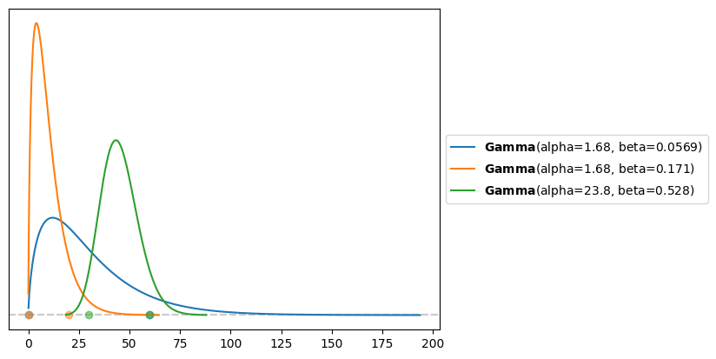
Prior
Let’s look at the effect of different priors
Which is the least informative?
Which is likely wrongly informative?

Slide 21
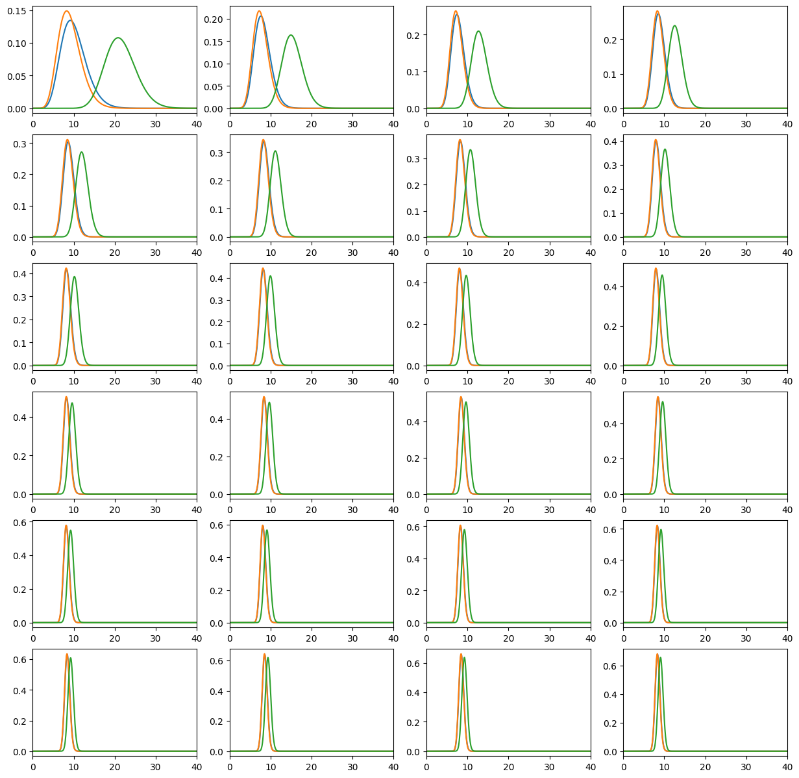

Posterior
Simulated data $\left(λ=8\right)$
The weakly informative prior
converged to the informative
correct one quickly.
Even the wrong prior gives a
final similar result after only
24 data points.

Slide 22
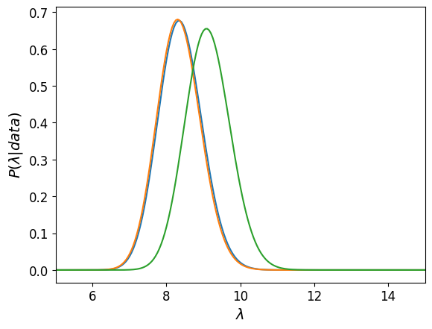
Posterior
Final posterior

Slide 23
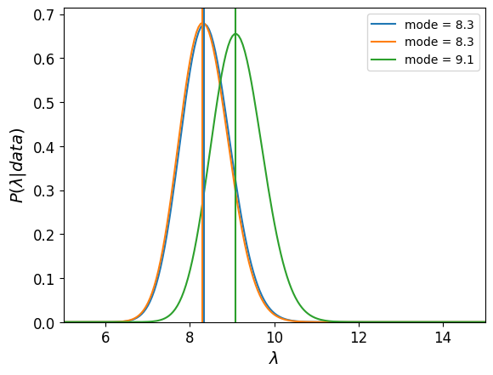
Posterior
Final posterior
Let’s compute the mode of each posterior

Slide 24
Models and Bayes
A model has
Probability distributions
Parameters
Probabilities are used to measure the uncertainty we have about parameters
Bayes’ theorem is a mechanism to correctly update those probabilities in light of new data

Slide 25
Bayesian Inference
The result of a Bayesian analysis is a posterior distribution – not a single value but a distribution of plausible values given the data and our model.
The most probable value is the mode of the posterior.
The spread of the posterior reflects the uncertainty about the value of the parameter.
The more data we have, the less the prior effects the posterior.
Given a sufficiently large amount of data, two or more Bayesian models with different priors will tend to converge to the same result. In the limit of infinite data, no matter which prior we use, all of them will provide the same posterior.

Slide 26
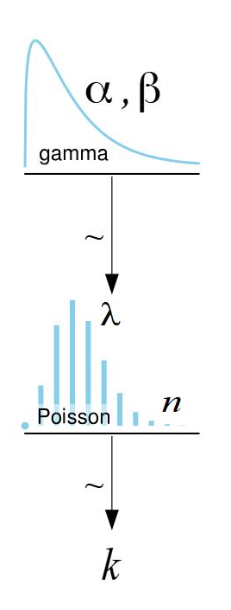
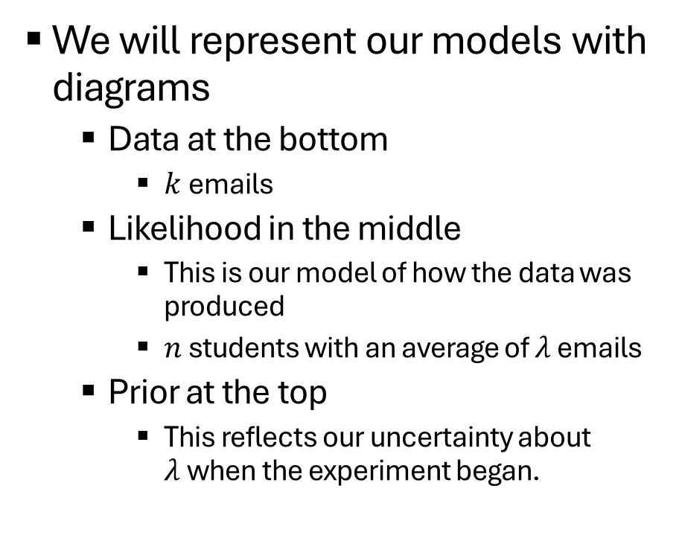
Model Visualization
We will represent our models with diagrams
Data at the bottom
$k$emails
Likelihood in the middle
This is our model of how the data was produced
$n$ students with an average of $λ$ emails
Prior at the top
This reflects our uncertainty about $λ$when the experiment began.

Slide 27
Model Visualization - downloads
Download LibreOffice:
Download LibreOffice | LibreOffice - Free and private office suite - Based on OpenOffice - Compatible with Microsoft
Download diagrams template:
https://www.sumsar.net/blog/2013/10/diy-kruschke-style-diagrams/

Slide 28
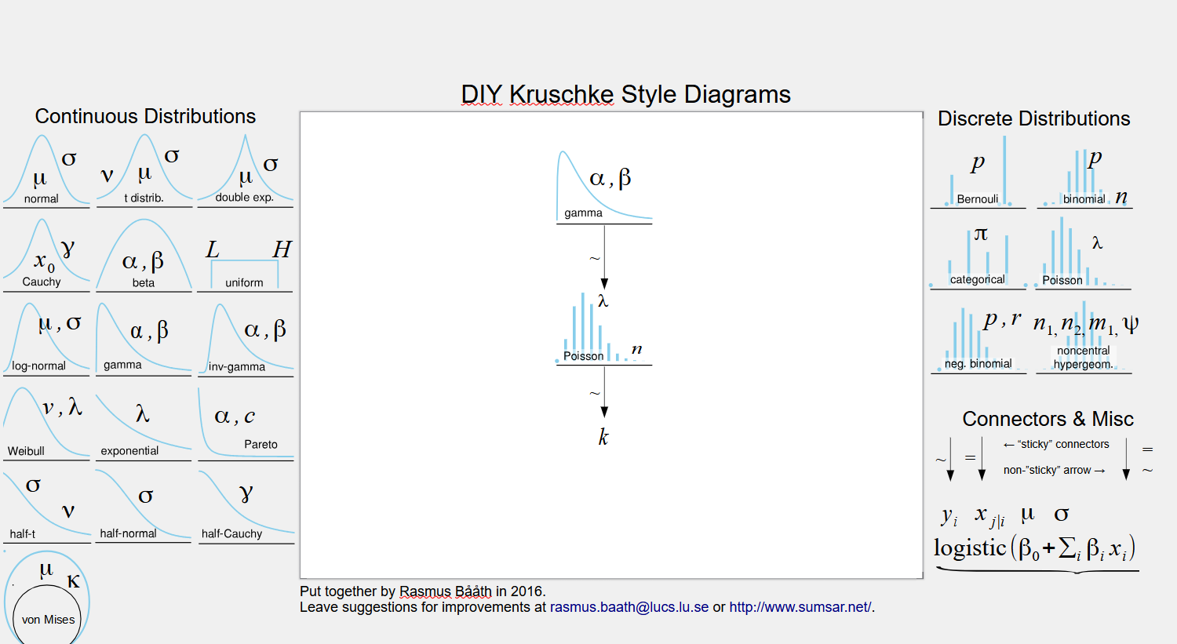
Model Visualization - Explanations
Copy-paste and drag
Double click to edit
To save: export + selection -> as jpeg
Notes:
Then open and create our model together

Slide 29
More About Priors
We used the maxent function
There are a lot of priors that would give X% of the range in a given distribution.
Which should we choose?
Maximizing the entropy means choosing the probability distribution that is the most uncertain (least biased) while still satisfying given constraints.
This guarantees that we have the less informative distribution, given a set of constraints.

Slide 30
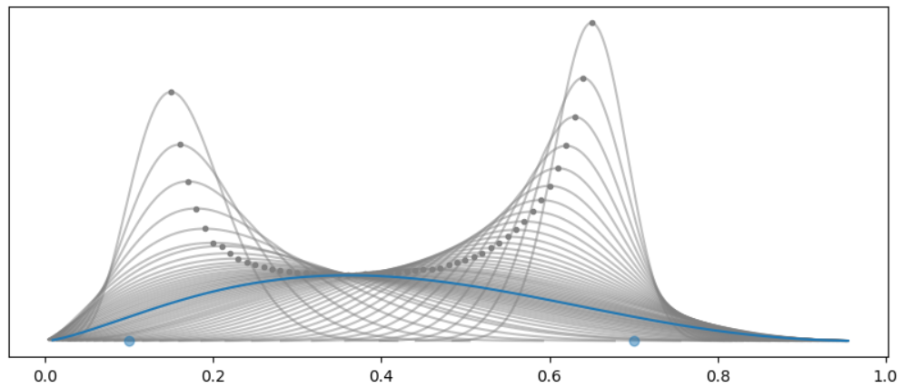
More About Priors
Visualizes this for a beta prior with 90% of the mass between 0.1-0.7
The blue maximizes the entropy

Slide 31


More About Priors
In our example, we used a gamma prior, where all we set was the range and the percentage of the distribution.
We can also add constraints, such as the mean.
Here, the mean has to be 4.
If you pass a distribution with all the parameters specified, like pz.Gamma(mu=4, sigma=1), you will get an error saying “All parameters are fixed, at least one should be free”.

Slide 32
More About Priors
We can also fix other properties, such as the mode.

Slide 33
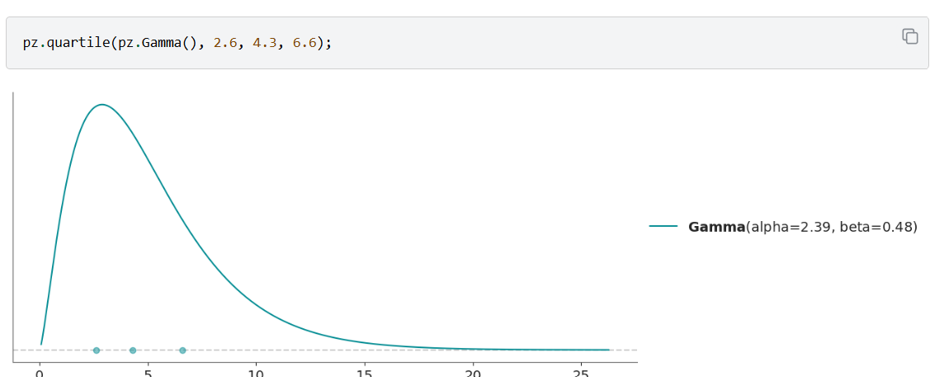
More About Priors
We can also use methods other than maximizing the entropy.
We can define a distribution by its quartiles, that is by the 3 points which divides the distribution into 4 parts each with 25% of the total mass.

Slide 34
More About Priors
A few more options can be found:
https://preliz.readthedocs.io/en/latest/examples/gallery/direct_elicitation_1D.html
Reminder: we can also plot interactively using:
pz.Gamma(mu=2, sigma=1).plot_interactive()

Slide 35
Another example – not the coin flipping
In slide 29, how does the probability get to above 1? Probaiblity density – in tutorial 2
As we add more data, the data will dominate the prior – important point
Notes:
Denomenator: it does not depend on data, and the posterior is a probability.
Low dimension – there will be some constant there.
If we’re not in low dimension, the proportaional can do fine, but we don’t know what the normalizing constant is. Going to sampling solves that problem. Cause each sample has the probabability of 1/number of samples. MCMC does its algorithm on relative probabilities, the question whether to jump .
Its not that its not important, it is, we just have an algorithm that lets us get by without that.
We should be careful to always put the normalizing constant, and then go to proportionate because we’re interested in the shape.

Slide 36
Another example – not the coin flipping
Start with bayes.
Show that we’re going to look at the proportion – and therefore not at the marginal. Really understand why this is ok.
Then give at least one example here of likelihood.
Including showing the effect of the amount of data of the likelihood.
Go into detail about the meaning of the likelihood.

Slide 37
Another example – not the coin flipping
Go into the difference (understanding and definition wise) between the likelihood and the posterior. – not here in the order.
Return to bayes, show that we need the prior.
Talk about priors.
When we’re done with the priors, go back to bayes again and then show the posterior and really explain that this is what we’re aiming to get.

Slide 38
Another example – not the coin flipping
Show the effect of amounts of data on the likelihood and then the posterior.
Show the effect of the prior with the same likelihood on the posterior.

Slide 39
Why use the beta distribution as a prior for the binomial likelihood
Range of 0 to 1 makes sense for probility
Flexibility to represent many possible priors
The beta distribution is a conjugate prior for the binomial likelihood
A conjugate prior for a likelihood:
A family of priors where the posterior will also be in the family.
Another example of a conjugate prior is normal for normal

Slide 40
Another example – not the coin flipping
How are they meant to know how to choose a and b in the beta prior?
The result of a Bayesian analysis is a posterior distribution – not a single value, but a distribution of plausible values given the data and our model.
The most probable value is given by the mode of the posterior.
The spread of the parameter is proportional to the uncertainty about the value of a parameter.

Slide 41
Another example – not the coin flipping
Given a sufficiently large amount of data, two or more Bayesian models with different priors will tend to converge to the same result.
In the limit of infinite data, all priors will lead to the same posterior.
Sequential update of the posterior – discuss how its actually done.

Slide 42
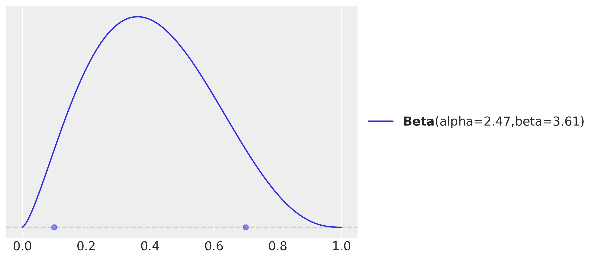
Preliz: a package for prior elicitation
I’m pretty sure the coin’s probability is somewhere between 0.1 and 0.7
maxent finds a Beta prior with X% of the probability between low and high
And displays it
import preliz as pz
dist = pz.Beta()
pz.maxent(dist, 0.1, 0.7, 0.9)
Notes:
Why maximum entropy distribution? Because that is
equivalent to computing the least informative distribution under those constraints.

Slide 43
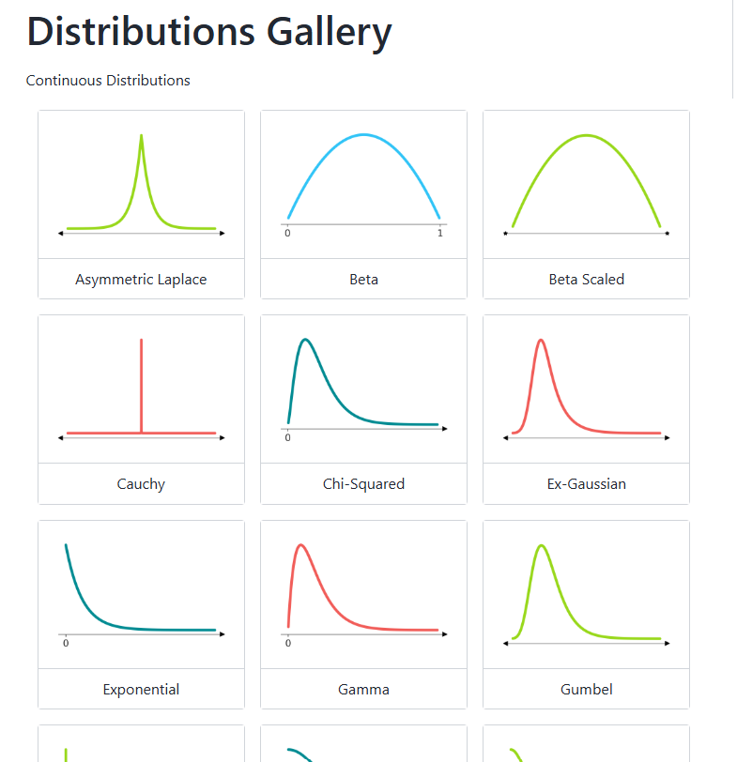
Preliz is handy for learning distributions
See the full gallery here:
https://preliz.readthedocs.io/en/latest/gallery_content.html
We will use many of these distributions.
This is a great reference
And it can also help in prior selection
Notes:
Visualization and HDI

